Slide 1

Customer Shopping Behavior Analysis
Uncovering actionable insights from 3,900 customer transactions to drive strategic business growth and enhance customer engagement across all touchpoints.

Slide 2
Project Overview & Strategic Goals
This comprehensive analysis examines customer shopping behavior using rich transactional data spanning 3,900 purchases across diverse product categories. Our goal is to uncover actionable insights into spending patterns, customer segmentation, product preferences, and subscription behavior.
3.9K
Total Purchases
By combining Python for data preparation, SQL for business analysis, and Power BI for visualization, we've created a multi-layered approach to understanding our customers. These insights will guide strategic decisions in marketing, product positioning, and customer retention initiatives.
Analyzed transactions
18
Data Features
Key variables tracked
4
Categories
Product segments

Slide 3
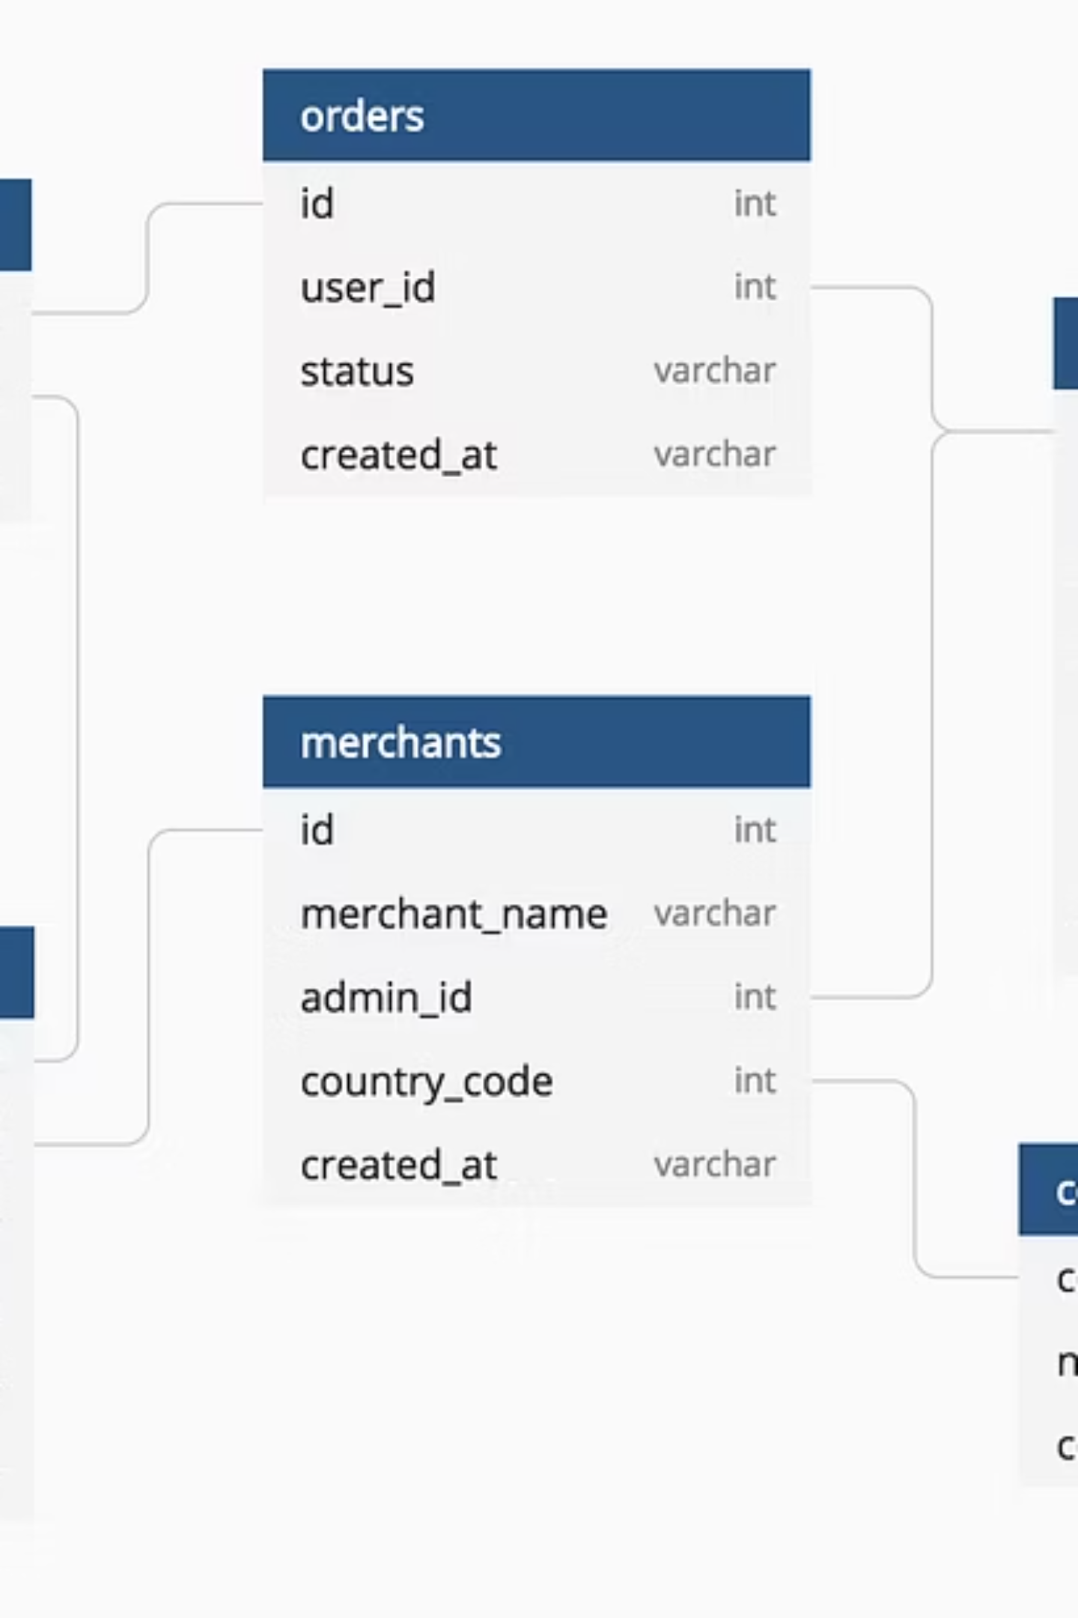
Dataset Structure & Key Features
Customer Demographics
Purchase Details
Age distribution (18-70 years)
Item purchased & category
Gender identification
Purchase amount ($20-$100)
Geographic location (50 states)
Seasonal patterns
Subscription status tracking
Size and color preferences
Shopping Behavior
Discount and promo usage
Previous purchase history
Purchase frequency metrics
Review ratings & shipping type
The dataset provides a comprehensive view of customer interactions, with only 37 missing values in the Review Rating column—representing less than 1% of total data, ensuring high-quality analysis.

Slide 4




Data Preparation Process in Python
Data Loading
Data Cleaning
Imported dataset using pandas and performed initial structure validation with df.info() and .describe() methods
Handled 37 missing Review Ratings using category-wise median imputation for accuracy
Feature Engineering
Database Integration
Created age_group bins and purchase_frequency_days to enable segmentation analysis
Connected to PostgreSQL and loaded cleaned data for advanced SQL querying
We standardized all column names to snake_case for consistency and dropped the redundant promo_code_used column after confirming it matched discount_applied data. This systematic approach ensured data integrity and prepared our dataset for robust business analysis.

Slide 5
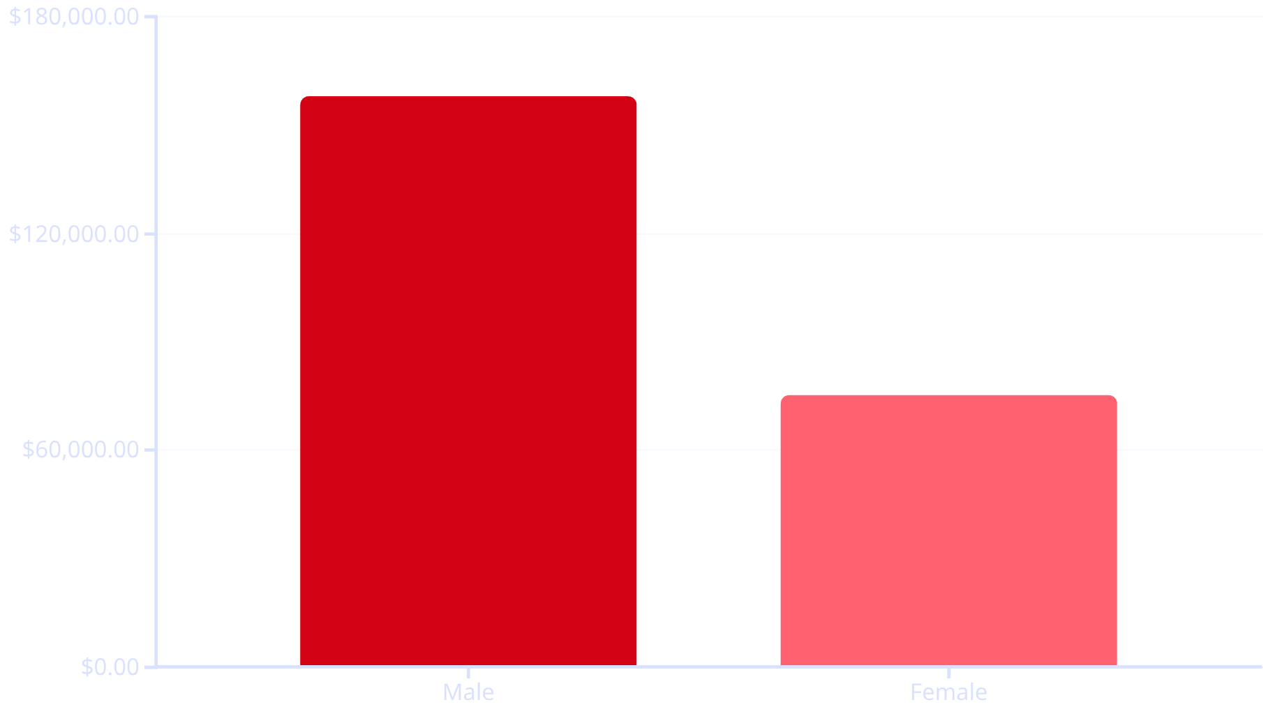
Revenue Analysis: Gender Insights
Key Finding
Male customers generate significantly higher total revenue, contributing $157,890 compared to $75,191 from female customers—representing a 2.1x difference in total spending.
This disparity could indicate:
Higher male customer volume in dataset
Different purchasing patterns by gender
Opportunity for targeted female marketing
Potential product assortment gaps

Slide 6
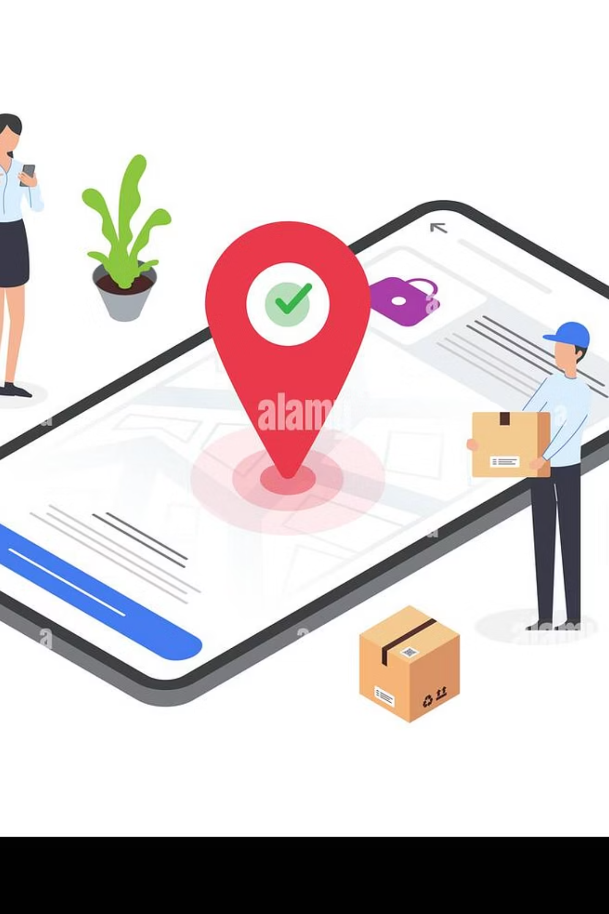
Customer Behavior Deep Dive
High-Value Discount Users
Top-Rated Products
We identified 839 customers who used discounts yet still spent above the average purchase amount of $59.76. These price-conscious high spenders represent a key segment—they respond to promotions while maintaining strong basket values.
Gloves lead with a 3.86 rating, followed by Sandals (3.84), Boots (3.82), Hats (3.80), and Skirts (3.78). These highly-rated items should be featured prominently in marketing campaigns to leverage social proof.
Shipping Preferences
Express shipping customers spend an average of $60.48 compared to $58.46 for Standard shipping—a $2.02 premium. This suggests convenience-seeking customers have slightly higher purchase values.

Slide 7
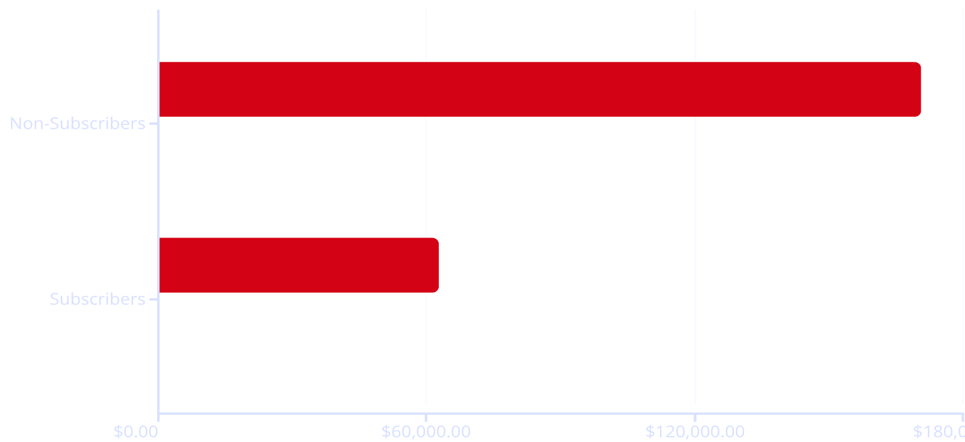
Subscription Status Impact Analysis
Surprising Findings
While subscribers and non-subscribers have nearly identical average spending ($59.49 vs $59.87), non-subscribers generate 2.7x more total revenue due to their larger volume (2,847 vs 1,053 customers).
Strategic Implication: There's massive untapped potential in converting non-subscribers. Even modest conversion rates could significantly boost predictable revenue streams.
Total Revenue
Avg Spend

Slide 8




Customer Segmentation & Loyalty Patterns
Loyal (3,116)
Returning (701)
New (83)
Our customer base is remarkably mature, with 80% classified as Loyal customers based on purchase history. This strong retention foundation is excellent, but the small proportion of New customers (2%) suggests we may need to invest more in acquisition marketing to fuel future growth.
Repeat Buyer Subscription Correlation
Among customers with 5+ purchases, 2,518 are non-subscribers versus only 958 subscribers. This represents a significant opportunity—frequent buyers aren't converting to subscriptions at expected rates.

Slide 9

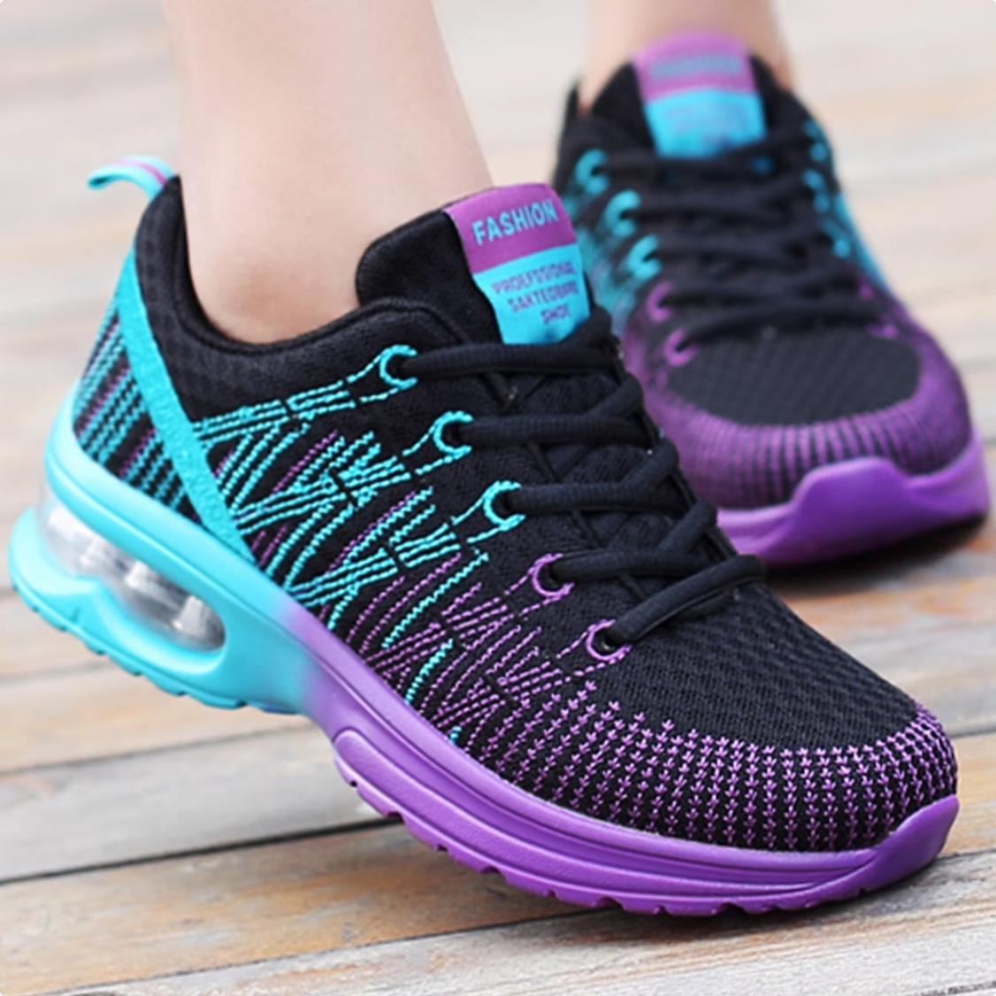


Product Performance & Discount Dynamics
Hats (50% Discount Rate)
Sneakers (49.66%)
Coats (49.07%)
Highest discount dependency
Nearly half sold with discounts
Heavy promotional reliance
These products show the highest percentage of discounted purchases, indicating potential margin pressure. Consider whether these items can maintain velocity at full price, or if reposition strategies (bundling, value messaging) could reduce discount dependency.
Top Sellers by Category: Clothing leads with Blouses, Pants, and Shirts; Footwear features Sandals, Shoes, and Sneakers; Accessories highlights Jewelry, Sunglasses, and Belts; Outerwear showcases Jackets and Coats.

Slide 10




Strategic Recommendations
Boost Subscription Conversion
Age-Targeted Marketing
Target the 2,518 repeat buyers without subscriptions through exclusive member benefits, early access to sales, and personalized product recommendations
Young Adults generate the highest revenue ($62,143). Develop campaigns that resonate with this demographic while exploring growth in underserved segments
Optimize Discount Strategy
Leverage Top Performers
Review pricing for Hats, Sneakers, and Coats—50% discount rates suggest margin erosion. Test value-based messaging and strategic bundling
Feature high-rated products (Gloves, Sandals, Boots) prominently in campaigns. Social proof drives conversion and builds brand trust
Loyalty Program Enhancement
Acquisition Investment
With 80% loyal customers, introduce tiered rewards to move Returning customers into Loyal status and increase lifetime value
Only 2% are new customers. Allocate budget to acquisition channels to ensure sustainable growth pipeline beyond existing base

